Slide 1


Slide 2


Slide 3


Slide 4


Slide 5


Slide 6
BULL Spread and Bear spread

Slide 7
BULL Spread (call)

Slide 8
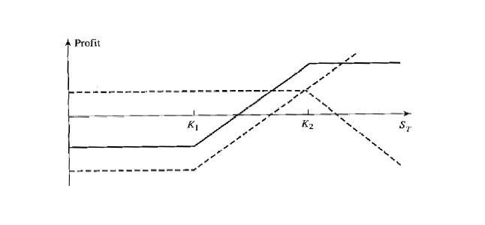
BULL Spread with call option
This can be creating by buying a call option on a stock with a certain strike price and sell a call option on the same stock with a higher strike price.

Slide 9
Let’s consider a Problem…
A trader might construct a bull spread by buying a call option with a $30 strike price (premium $3) and selling a call option with a $35 strike (premium $1) .

Slide 10
Price | K = 30, premium = 3 | K = 35, premium = 1 | Net payoff
25
26
27
28
29
30
31
32
33
34
35
36
37
38
39

Slide 11
Price | K = 30, premium = 3 + | K = 35, premium = 1 - | Bull Spread
25 | -3 | 1 | -2
26 | -3 | 1 | -2
27 | -3 | 1 | -2
28 | -3 | 1 | -2
29 | -3 | 1 | -2
30 | -3 | 1 | -2
31 | -2 | 1 | -1
32 | -1 | 1 | 0
33 | 0 | 1 | 1
34 | 1 | 1 | 2
35 | 2 | 1 | 3
36 | 3 | 0 | 3
37 | 4 | -1 | 3
38 | 5 | -2 | 3
39 | 6 | -3 | 3

Slide 12
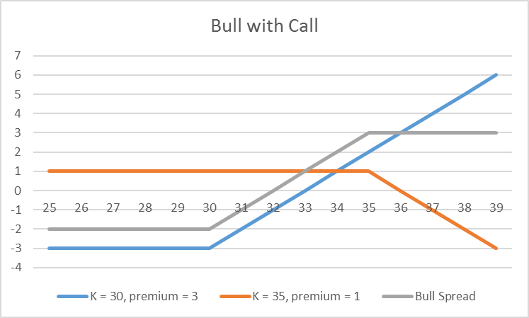

Slide 13
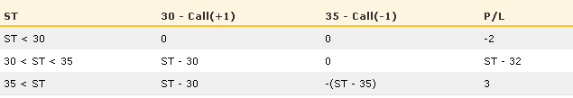
Table shows the profit/loss over various stock price ranges for this scenario

Slide 14
BULL Spread (put)

Slide 15
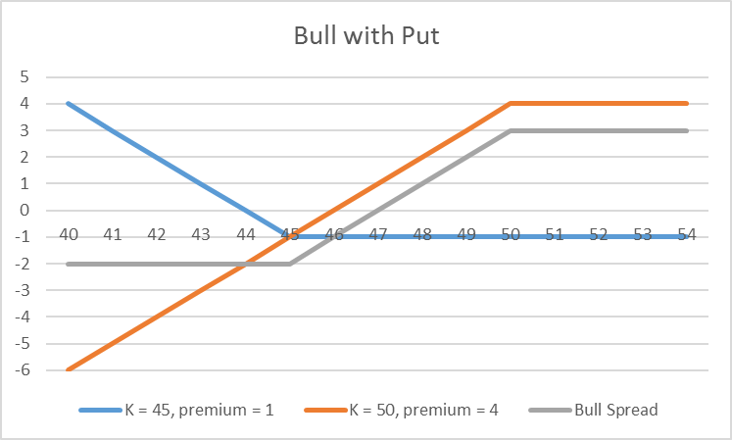
BULL Spread with put option
This can be creating by selling a put option on a stock with a certain strike price and buy a put option on the same stock with a lower strike price.

Slide 16
Price | K = 45, premium = 1 | K = 50, premium = 4 | Net payoff
40
41
42
43
44
45
46
47
48
49
50
51
52
53
54

Slide 17
Price | K = 45, premium = 1 + | K = 50, premium = 4 - | Bull Spread
40 | 4 | -6 | -2
41 | 3 | -5 | -2
42 | 2 | -4 | -2
43 | 1 | -3 | -2
44 | 0 | -2 | -2
45 | -1 | -1 | -2
46 | -1 | 0 | -1
47 | -1 | 1 | 0
48 | -1 | 2 | 1
49 | -1 | 3 | 2
50 | -1 | 4 | 3
51 | -1 | 4 | 3
52 | -1 | 4 | 3
53 | -1 | 4 | 3
54 | -1 | 4 | 3

Slide 18
BULL Spread with put option

Slide 19
Please note that
A bull spread strategies limits the invertors upside as well as downside risk.

Slide 20
Now
Comparison

Slide 22
Bear Spread (put)

Slide 23
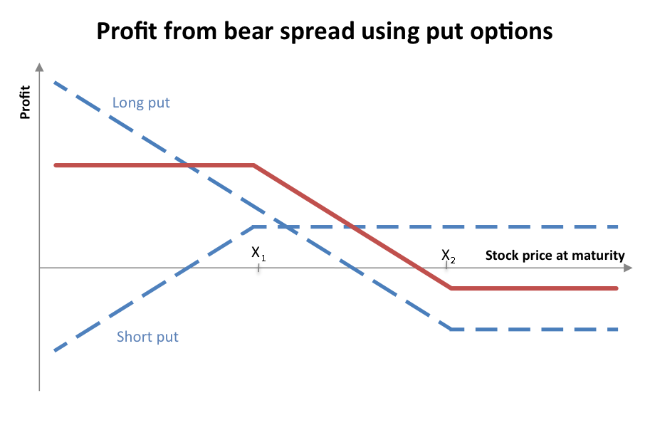
bear Spread with put option
This can be creating by buying a put option on a stock with a certain strike price and sell a put option on the same stock with a lower strike price.

Slide 24
For example, a trader might construct a bear spread by selling a put with $30 strike price ($2premium) and buying a put option with $35 strike price ($4 premium)

Slide 25
Price | K = 30, premium = 2 | K = 35, premium = 4 | Net payoff
25
26
27
28
29
30
31
32
33
34
35
36
37
38
39

Slide 26
Price | K = 30, Premium = 2 - | K = 35, Premium = 4 + | Bear Spread
25 | -3 | 6 | 3
26 | -2 | 5 | 3
27 | -1 | 4 | 3
28 | 0 | 3 | 3
29 | 1 | 2 | 3
30 | 2 | 1 | 3
31 | 2 | 0 | 2
32 | 2 | -1 | 1
33 | 2 | -2 | 0
34 | 2 | -3 | -1
35 | 2 | -4 | -2
36 | 2 | -4 | -2
37 | 2 | -4 | -2
38 | 2 | -4 | -2
39 | 2 | -4 | -2

Slide 27
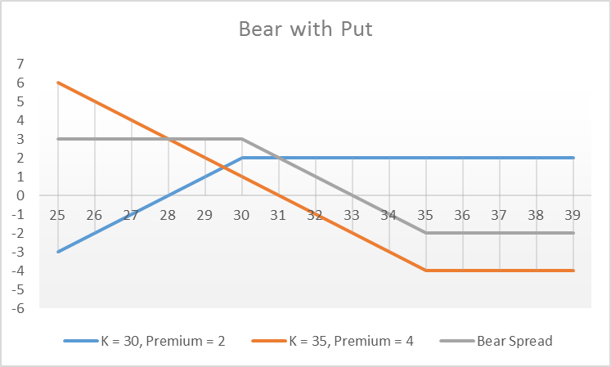

Slide 28
Now
Comparison

Slide 30
Bear Spread (call)

Slide 31
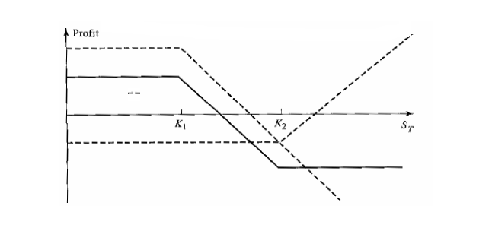
bear Spread with call option
This can be creating by buying a call option on a stock with a certain strike price and sell a call option on the same stock with a lower strike price.

Slide 32
Let’s consider a Problem…
A trader might construct a Bear spread by buying a call option with a $35 strike price (premium $2) and selling a call option with a $30 strike (premium $4) .

Slide 33
Price | K = 30, premium = 4 | K = 35, premium = 2 | Net payoff
25
26
27
28
29
30
31
32
33
34
35
36
37
38
39

Slide 34
Price | K = 30, Premium = 4 - | K = 35, Premium = 2 + | Bear Spread
25 | 4 | -2 | 2
26 | 4 | -2 | 2
27 | 4 | -2 | 2
28 | 4 | -2 | 2
29 | 4 | -2 | 2
30 | 4 | -2 | 2
31 | 3 | -2 | 1
32 | 2 | -2 | 0
33 | 1 | -2 | -1
34 | 0 | -2 | -2
35 | -1 | -2 | -3
36 | -2 | -1 | -3
37 | -3 | 0 | -3
38 | -4 | 1 | -3
39 | -5 | 2 | -3

Slide 35
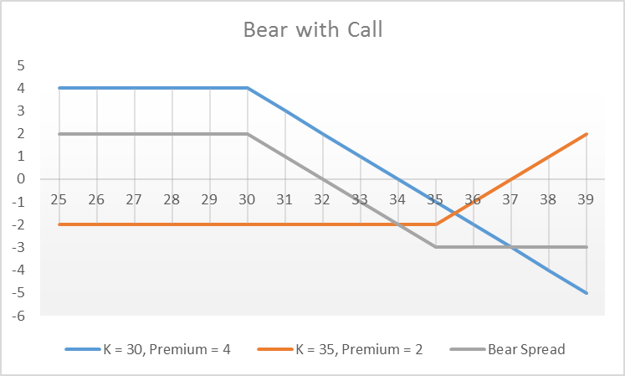

Slide 36
Now
Comparison

Slide 37
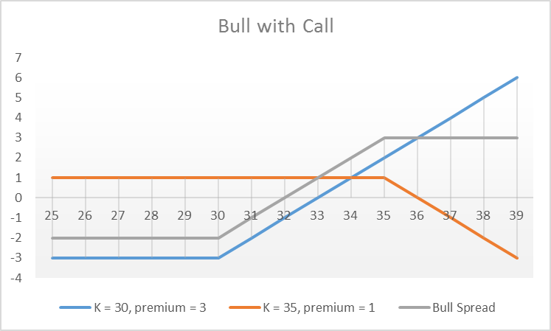

Slide 38


Slide 39
Box Spreads

Slide 40
Box Spreads
A box spread is a combination of
A bull call spread with strike prices K1 and K2
A bear put spread with the same two strike prices.
The payoff from a box spread is always K₂ — K₁
The value of a box spread is therefore always the present value of this payoff or (K₂ — K₁)e^{-rT}
If it has a different value there is an arbitrage opportunity.

Slide 41
Box Spreads
If the market price of the box spread is too low, it is profitable to buy the box. This involves
Buying a call K1
Selling a call K2
Selling a put K1
Buying a put K2
If The Market Price Of The Box Spread Is Too High, It Is Profitable To Sell The Box.
This Involves Buying A Call With Strike Price K2, Buying A Put With Strike Price K1, Selling A Call With Strike Price K1, And Selling A Put With Strike Price K2.
Bull (Call) spread
Bear (Put) spread

Slide 42
Example
Consider a three-month option on a stock whose current price is $100
The initial investment for a long box spread would be $19.30
The terminal payoff has a value of $ 20 independent of the terminal value of the share price. The discounted value of the payoff is $ 19.60. Hence there is a Nominal profit of 30 cents
 | Call | Put
K1 = 90 | 13.1 | 1.65
K2 = 110 | 3.05 | 10.9

Slide 43
Buying a call 30 Selling a call 35 Selling a put 30 Buying a put 35
Price | (Put)K = 30, Premium = 2 | (Put)K = 35, Premium = 4 | (Call)K = 30, premium = 3 | (Call)K = 35, premium = 1 | BOX
25
26
27
28
29
30
31
32
33
34
35
36
37
38
39

Slide 44
Buying a call 30 Selling a put 30 Selling a call 35 Buying a put 35
Price | (Put)K = 30, Premium = 2 | (Put)K = 35, Premium = 4 | (Call)K = 30, premium = 3 | (Call)K = 35, premium = 1 | BOX
25 | -3 | 6 | -3 | 1 | 1
26 | -2 | 5 | -3 | 1 | 1
27 | -1 | 4 | -3 | 1 | 1
28 | 0 | 3 | -3 | 1 | 1
29 | 1 | 2 | -3 | 1 | 1
30 | 2 | 1 | -3 | 1 | 1
31 | 2 | 0 | -2 | 1 | 1
32 | 2 | -1 | -1 | 1 | 1
33 | 2 | -2 | 0 | 1 | 1
34 | 2 | -3 | 1 | 1 | 1
35 | 2 | -4 | 2 | 1 | 1
36 | 2 | -4 | 3 | 0 | 1
37 | 2 | -4 | 4 | -1 | 1
38 | 2 | -4 | 5 | -2 | 1
39 | 2 | -4 | 6 | -3 | 1

Slide 45
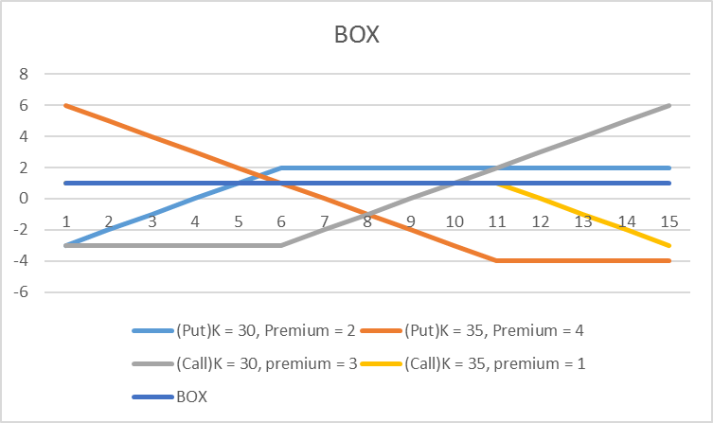
Box Spreads

Slide 46
Butterfly Spreads
A butterfly spread involves positions in options with three different strike prices.
It can be created by buying
Buying a call option low strike price k1
Buying a call option high strike price k3
Selling 2 call options with a strike price k2 (halfway between k1 and k3).
Generally, k2 is close to the current stock price
A butterfly spread leads to a profit if the stock price stays close to k2,
A small loss if there is a significant stock price move in either direction.

Slide 47
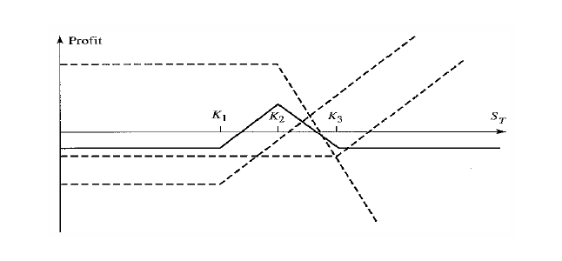
Butterfly Spreads

Slide 48
Example
It costs $10 + $5 — (2 >< $7) = $1 to create the spread.
If the stock price in 6 months is greater than $65 or less than $55, the total payoff is zero, and the investor incurs a net loss of $1.
If the stock price is between $56 and $64, no profit no loss.
The maximum profit, $4, occurs when the stock price in 6 months is $60.
K | Call
55 | 10
60 | 7
65 | 5

Slide 49
 | Buy | Sell | Buy
Price | K = 55, premium = 10 | K = 60, premium = 7 | K = 65, premium = 5 | Butterfly
50
51
52
53
54
55
56
57
58
59
60
61
62
63
64
65
66
67
68
69
70
71
72
73

Slide 50
 | Buy | Sell | Buy
Price | K = 55, premium = 10 | K = 60, premium = 7 | K = 65, premium = 5 | Butterfly
50 | -10 | 14 | -5 | -1
51 | -10 | 14 | -5 | -1
52 | -10 | 14 | -5 | -1
53 | -10 | 14 | -5 | -1
54 | -10 | 14 | -5 | -1
55 | -10 | 14 | -5 | -1
56 | -9 | 14 | -5 | 0
57 | -8 | 14 | -5 | 1
58 | -7 | 14 | -5 | 2
59 | -6 | 14 | -5 | 3
60 | -5 | 14 | -5 | 4
61 | -4 | 12 | -5 | 3
62 | -3 | 10 | -5 | 2
63 | -2 | 8 | -5 | 1
64 | -1 | 6 | -5 | 0
65 | 0 | 4 | -5 | -1
66 | 1 | 2 | -4 | -1
67 | 2 | 0 | -3 | -1
68 | 3 | -2 | -2 | -1
69 | 4 | -4 | -1 | -1
70 | 5 | -6 | 0 | -1
71 | 6 | -8 | 1 | -1
72 | 7 | -10 | 2 | -1
73 | 8 | -12 | 3 | -1

Slide 52
Butterfly Spreads
Butterfly spreads can be created using put options.
Buying a put option low strike price K1
Buying a put option high strike price K3
Selling 2 put options with a strike price K2 (halfway between K1 and K3).

Slide 53
Butterfly Sell
A butterfly spread involves positions in options with three different strike prices.
It can be created by buying
Selling a call option low strike price k1
Selling a call option high strike price k3
Buying 2 call options with a strike price k2 (halfway between k1 and k3).
Generally, k2 is close to the current stock price
A butterfly sell spread leads to a profit if the stock price stays far away to k2,
A small loss if the stock price stays close to k2

Slide 54
 | Sell | Buy | Sell
Price | K = 55, premium = 10 | K = 60, premium = 7 | K = 65, premium = 5 | Butterfly
50
51
52
53
54
55
56
57
58
59
60
61
62
63
64
65
66
67
68
69
70
71
72
73

Slide 55
 | Sell | Buy | Sell
Price | K = 55, premium = 10 | K = 60, premium = 7 | K = 65, premium = 5 | Butterfly
50 | 10 | -14 | 5 | 1
51 | 10 | -14 | 5 | 1
52 | 10 | -14 | 5 | 1
53 | 10 | -14 | 5 | 1
54 | 10 | -14 | 5 | 1
55 | 10 | -14 | 5 | 1
56 | 9 | -14 | 5 | 0
57 | 8 | -14 | 5 | -1
58 | 7 | -14 | 5 | -2
59 | 6 | -14 | 5 | -3
60 | 5 | -14 | 5 | -4
61 | 4 | -12 | 5 | -3
62 | 3 | -10 | 5 | -2
63 | 2 | -8 | 5 | -1
64 | 1 | -6 | 5 | 0
65 | 0 | -4 | 5 | 1
66 | -1 | -2 | 4 | 1
67 | -2 | 0 | 3 | 1
68 | -3 | 2 | 2 | 1
69 | -4 | 4 | 1 | 1
70 | -5 | 6 | 0 | 1
71 | -6 | 8 | -1 | 1
72 | -7 | 10 | -2 | 1
73 | -8 | 12 | -3 | 1

Slide 56
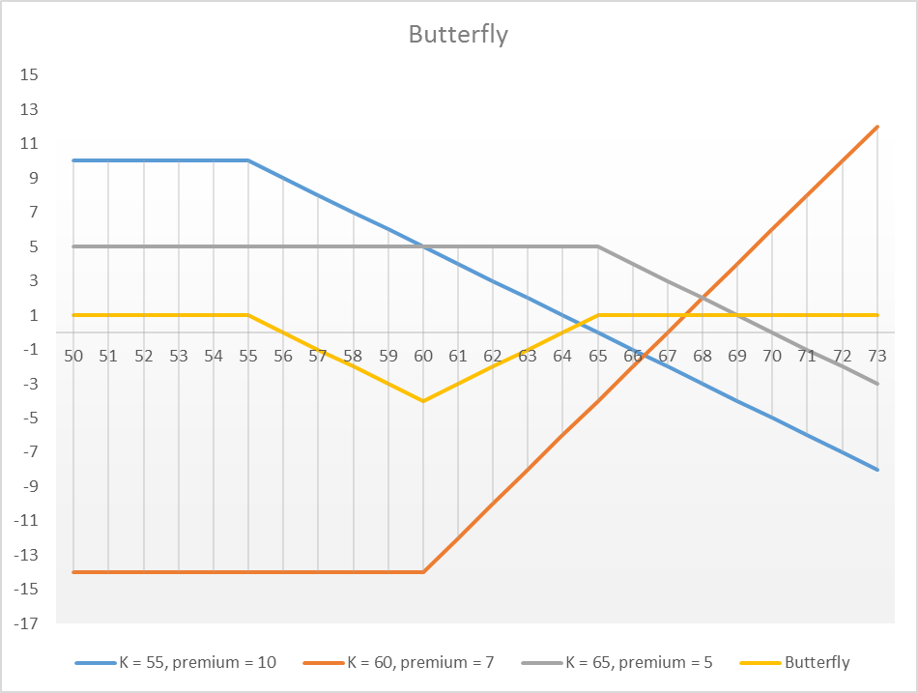

Slide 57
Now
Comparison

Slide 59
straddle
There are two type of straddle
Bottom straddle or straddle purchase
Top straddle or straddle write.

Slide 60
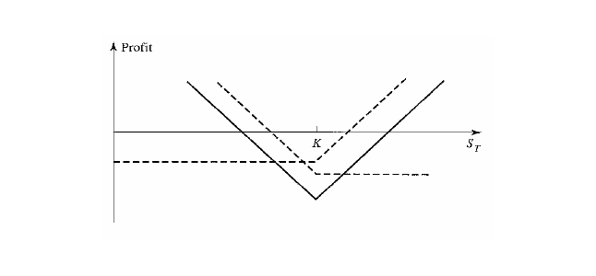
Bottom straddle or straddle purchase
A bottom straddle is made up of
A long call
A long put with the same strike price and expiry
Profits from large price movements.

Slide 61
The profit/loss over various stock price ranges for a straddle consisting of a $60 strike long call costing $3 and a long put $60 strike costing $2

Slide 62
 | Call | Put
 | Buy | Buy
Price | K = 60, premium = 6 | K = 60, premium = 4 | Straddle purchase
50
51
52
53
54
55
56
57
58
59
60
61
62
63
64
65
66
67
68
69
70

Slide 63
 | Call | Put
 | Buy | Buy
Price | K = 60, premium = 6 | K = 60, premium = 4 | Straddle purchase
50 | -3 | 8 | 5
51 | -3 | 7 | 4
52 | -3 | 6 | 3
53 | -3 | 5 | 2
54 | -3 | 4 | 1
55 | -3 | 3 | 0
56 | -3 | 2 | -1
57 | -3 | 1 | -2
58 | -3 | 0 | -3
59 | -3 | -1 | -4
60 | -3 | -2 | -5
61 | -2 | -2 | -4
62 | -1 | -2 | -3
63 | 0 | -2 | -2
64 | 1 | -2 | -1
65 | 2 | -2 | 0
66 | 3 | -2 | 1
67 | 4 | -2 | 2
68 | 5 | -2 | 3
69 | 6 | -2 | 4
70 | 7 | -2 | 5

Slide 64
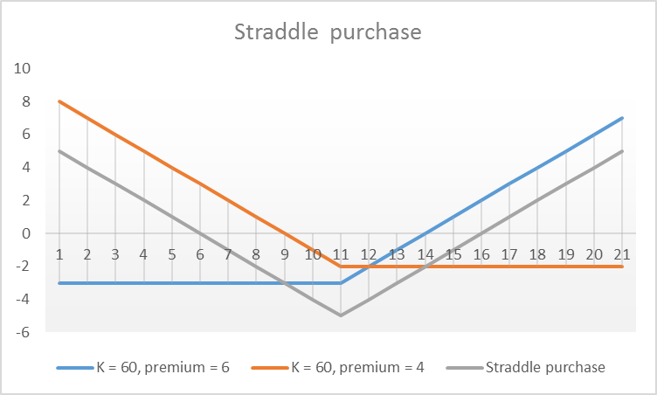

Slide 65
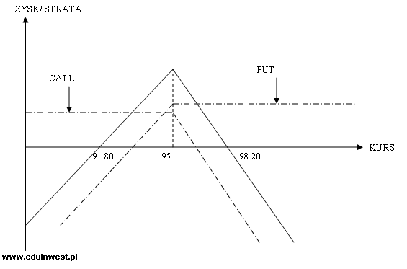
Top straddle or straddle write
A Top straddle is made up of a short call and a short put with the same strike price and expiry, and profits from small price movements.

Slide 66
The profit/loss over various stock price ranges for a straddle consisting of a $60 strike short call costing $3 and a $60 strike short put costing $2

Slide 67
 | Call | Put
 | Sell | Sell
Price | K = 60, premium = 6 | K = 60, premium = 4 | Straddle Sell
50
51
52
53
54
55
56
57
58
59
60
61
62
63
64
65
66
67
68
69
70

Slide 68
 | Call | Put
 | Sell | Sell
Price | K = 60, premium = 6 | K = 60, premium = 4 | Straddle Sell
50 | 3 | -8 | -5
51 | 3 | -7 | -4
52 | 3 | -6 | -3
53 | 3 | -5 | -2
54 | 3 | -4 | -1
55 | 3 | -3 | 0
56 | 3 | -2 | 1
57 | 3 | -1 | 2
58 | 3 | 0 | 3
59 | 3 | 1 | 4
60 | 3 | 2 | 5
61 | 2 | 2 | 4
62 | 1 | 2 | 3
63 | 0 | 2 | 2
64 | -1 | 2 | 1
65 | -2 | 2 | 0
66 | -3 | 2 | -1
67 | -4 | 2 | -2
68 | -5 | 2 | -3
69 | -6 | 2 | -4
70 | -7 | 2 | -5

Slide 69
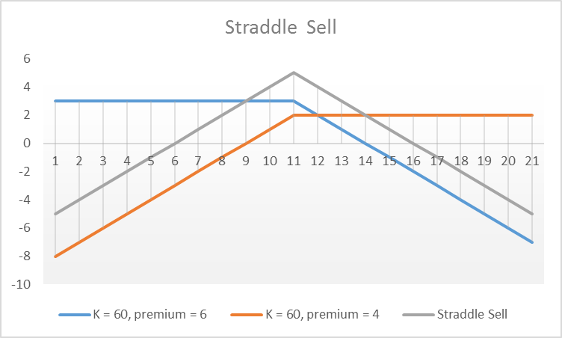

Slide 70
Now
Comparison

Slide 72

There are few more strategies.

Slide 73
Strips and Straps
And, these are …

Slide 74
Strips and Straps

Slide 75
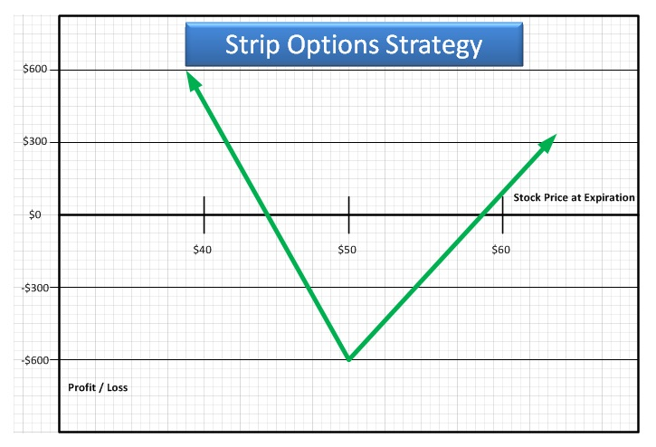
Strips
A strip strategy consists of a long one call and long two put with the same strike price and expiration date

Slide 76
Strips
In order to activate the Strip strategy
The trader will buy an ATM Call option trade and double the number of Put option trades.
These trades need to be for the same underlying asset, the same strike price as well as the same expiry time.
By using this strategy, the trader has the potential to limit risk and make profits
If the asset price does make a big move downwards as predicted, greater gains will be achieved.

Slide 77
 | Call | Put
 | Buy | 2 Buy
Price | K = 60, premium = 6 | K = 60, premium = 4 | Strips
50
51
52
53
54
55
56
57
58
59
60
61
62
63
64
65
66
67
68
69
70

Slide 78
 | Call | Put
 | Buy | 2 Buy
Price | K = 60, premium = 6 | K = 60, premium = 4 | Strips
50 | -3 | 16 | 13
51 | -3 | 14 | 11
52 | -3 | 12 | 9
53 | -3 | 10 | 7
54 | -3 | 8 | 5
55 | -3 | 6 | 3
56 | -3 | 4 | 1
57 | -3 | 2 | -1
58 | -3 | 0 | -3
59 | -3 | -2 | -5
60 | -3 | -4 | -7
61 | -2 | -4 | -6
62 | -1 | -4 | -5
63 | 0 | -4 | -4
64 | 1 | -4 | -3
65 | 2 | -4 | -2
66 | 3 | -4 | -1
67 | 4 | -4 | 0
68 | 5 | -4 | 1
69 | 6 | -4 | 2
70 | 7 | -4 | 3

Slide 79
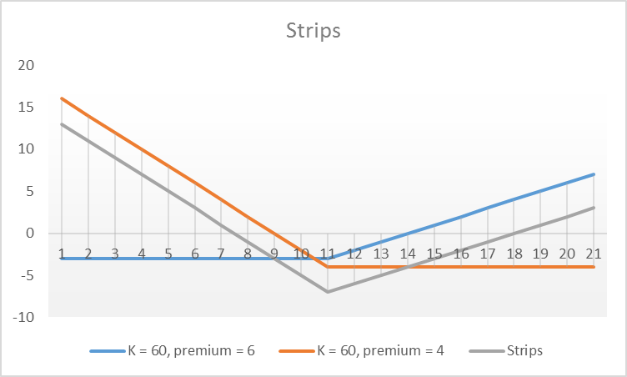

Slide 80

How can we make profit from this strategy
@@@######

Slide 81
Example
Say that Microsoft stocks are trading at 500 and you are accepting price will go down. So you can earn profit through strip. Cost of call option is 10 and cost of put option is 15.
Stock price | P/L from 1 call | P/L from 2 put | Net P/L
400 | 0 - 10 | 200 – 30 | 200 – 30 – 10 = 160
600 | 100 - 10 | 0 - 30 | 100 – 10 – 30 = 60
490 | 0 – 10 | 20 - 30 | 20 – 30 – 10 = -20
510 | 10 – 10 | 0 - 30 | 10 – 10 – 30 = -30
480 | 0 – 10 | 40 – 30 | 40 – 30 – 10 = 0
540 | 40 – 10 | 0 – 30 | 40 – 10 – 30 = 0

Slide 82
Straps

Slide 83
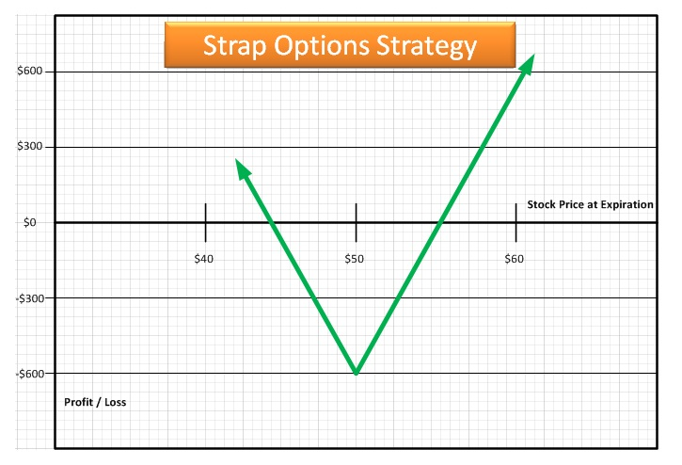
Straps
A strip strategy consists of a long two call and long one put with the same strike price and expiration date.

Slide 84
Strips
In order to activate the Strap strategy
The trader will buy two ATM Call option and one ATM Put option trades.
These trades need to be for the same underlying asset, the same strike price as well as the same expiry time.
By using this strategy, the trader has the potential to limit risk and make profits
If the asset price does make a big move upwards as predicted, greater gains will be achieved.

Slide 85
 | Call | Put
 | 2 Buy | Buy
Price | K = 60, premium = 6 | K = 60, premium = 4 | Straps
50
51
52
53
54
55
56
57
58
59
60
61
62
63
64
65
66
67
68
69
70

Slide 86
 | Call | Put
 | 2 Buy | Buy
Price | K = 60, premium = 6 | K = 60, premium = 4 | Straps
50 | -6 | 8 | 2
51 | -6 | 7 | 1
52 | -6 | 6 | 0
53 | -6 | 5 | -1
54 | -6 | 4 | -2
55 | -6 | 3 | -3
56 | -6 | 2 | -4
57 | -6 | 1 | -5
58 | -6 | 0 | -6
59 | -6 | -1 | -7
60 | -6 | -2 | -8
61 | -4 | -2 | -6
62 | -2 | -2 | -4
63 | 0 | -2 | -2
64 | 2 | -2 | 0
65 | 4 | -2 | 2
66 | 6 | -2 | 4
67 | 8 | -2 | 6
68 | 10 | -2 | 8
69 | 12 | -2 | 10
70 | 14 | -2 | 12

Slide 87
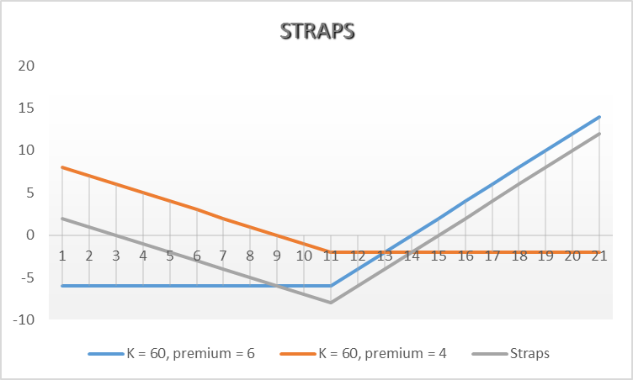

Slide 88
How can we make profit from this strategy
@@@######

Slide 89
Strips
Say that Microsoft stocks are trading at 500 and you are accepting price will go up. So you can earn profit through strap. Cost of call option is 10 and cost of put option is 15.
Stock price | P/L from 2 call | P/L from 1 put | Net P/L
400 | 0 - 20 | 100 – 15 | 100 – 20 – 15 = 65
600 | 200 - 20 | 0 - 15 | 200 – 20 – 15 = 165
490 | 0 – 20 | 10 - 15 | 10 – 15 – 20 = -25
510 | 10 – 20 | 0 - 15 | 10 – 20 – 15 = -25
465 | 0 – 20 | 35 – 15 | 35 – 20 – 15 = 0
517.5 | 35 – 20 | 0 – 15 | 35 – 20 – 15 = 0

Slide 90
Now
Comparison

Slide 92
Strangles

Slide 93
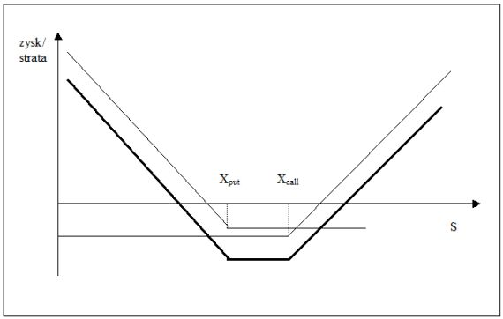
Strangles
In a strangle, sometimes called a bottom vertical combination,
Buys a European put
Buys a European call with the same expiration date and different strike prices.

Slide 94
Strangles
The investor is betting that there will be a large price move, but is uncertain whether it will be an increase or a decrease.
The sale of a strangle is sometimes referred to as a top vertical combination. It can be appropriate for an investor who feels that large stock price moves are unlikely.

Slide 95
 | Call | Put
 | Buy | Buy
Price | K = 62, premium = 4 | K = 58, premium = 2 | Strangles
50
51
52
53
54
55
56
57
58
59
60
61
62
63
64
65
66
67
68
69
70

Slide 96
 | Call | Put
 | Buy | Buy
Price | K = 62, premium = 4 | K = 58, premium = 2 | Strangles
50 | -4 | 6 | 2
51 | -4 | 5 | 1
52 | -4 | 4 | 0
53 | -4 | 3 | -1
54 | -4 | 2 | -2
55 | -4 | 1 | -3
56 | -4 | 0 | -4
57 | -4 | -1 | -5
58 | -4 | -2 | -6
59 | -4 | -2 | -6
60 | -4 | -2 | -6
61 | -4 | -2 | -6
62 | -4 | -2 | -6
63 | -3 | -2 | -5
64 | -2 | -2 | -4
65 | -1 | -2 | -3
66 | 0 | -2 | -2
67 | 1 | -2 | -1
68 | 2 | -2 | 0
69 | 3 | -2 | 1
70 | 4 | -2 | 2

Slide 97
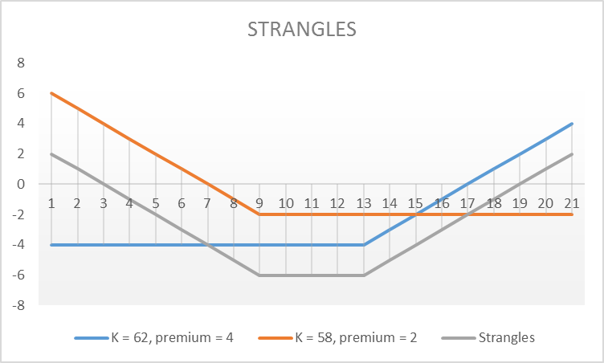

Slide 98
Now
Comparison

Slide 100


That’s all for the DAY!!!

